Slide 1
THEORY
Logic gates or logic gate is an entity in electronics and mathematics boolean that turns one or more logic inputs to a logic output signal. Logic gate is mainly implemented electronically using diodes or transistors, but can also be built using the arrangement of components that utilize the properties of electromagnetic (relay), fluids, optical or even mechanical. Any boolean algebra operation can be associated with inputs and outputs represent the statements of boolean algebra. Although these circuits may be complex , they may all be constructed from three bsic devices . We have three different types of logic gates . These are the AND gate, the OR gate and the NOT gate.

Slide 2
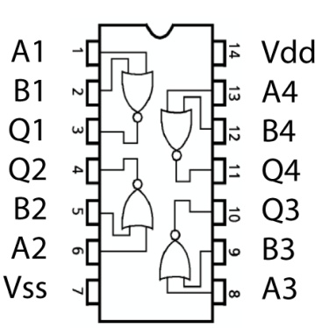
Hardware description and pinout
NOR Gates are basic logic gates, and as such they are recognised in TTL and CMOS ICs. The standard, 4000 series, CMOS IC is the 4001, which includes four independent, two-input, NOR gates. The pinout diagram is as follows
Availability
Availability
These devices are available from most semiconductor manufacturers such as Fairchild Semiconductor, Philips or Texas Instruments. These are usually available in both through- hole DIP and SOIC format. Datasheets are readily available in most datasheet databases.
In the popular CMOS and TTL logic families, NOR gates with up to 8 inputs are available:
CMOS
4001: Quad 2-input NOR gate
4025: Triple 3-input NOR gate
4002: Dual 4-input NOR gate
4078: Single 8-input NOR gate
TTL
7402: Quad 2-input NOR gate
7427: Triple 3-input NOR gate
7425: Dual 4-input NOR gate (with strobe, obsolete)
74260: Dual 5-Input NOR Gate
744078: Single 8-input NOR Gate
In the older RTL and ECL families, NOR gates were efficient and most commonly used.

Slide 3
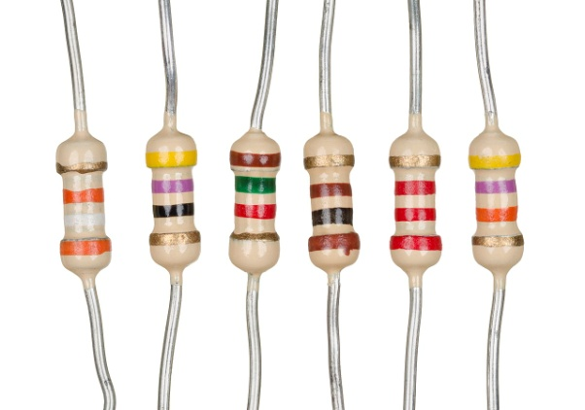
RESISTOR
A resistor is a passive two-terminal electrical component that implements electrical resistance as a circuit element. In electronic circuits, resistors are used to reduce current flow, adjust signal levels, to divide voltages, bias active elements, and terminate transmission lines, among other uses. High-power resistors that can dissipate many watts of electrical power as heat, may be used as part of motor controls, in power distribution systems, or as test loads for generators. Fixed resistors have resistances that only change slightly with temperature, time or operating voltage. Variable resistors can be used to adjust circuit elements (such as a volume control or a lamp dimmer), or as sensing devices for heat, light, humidity, force, or chemical activity.
Resistors are common elements of electrical networks and electronic circuits and are ubiquitous in electronic equipment. Practical resistors as discrete components can be composed of various compounds and forms. Resistors are also implemented within integrated circuits.
The electrical function of a resistor is specified by its resistance: common commercial resistors are manufactured over a range of more than nine orders of magnitude. The nominal value of the resistance falls within the manufacturing tolerance, indicated on the component.

Slide 4

ELECTRONIC SYMBOLS AND NOTATIONS
Two typical schematic diagram symbols are as follows:
&
IEC RESISTOR SYMBOL
The notation to state a resistor's value in a circuit diagram varies.
One common scheme is the RKM code following IEC 60062. It avoids using a decimal separator and replaces the decimal separator with a letter loosely associated with SI prefixes corresponding with the part's resistance. For example, 8K2 as part marking code, in a circuit diagram or in a bill of materials (BOM) indicates a resistor value of 8.2 kΩ. Additional zeros imply a tighter tolerance, for example 15M0 for three significant digits. When the value can be expressed without the need for a prefix (that is, multiplicator 1), an "R" is used instead of the decimal separator. For example, 1R2 indicates 1.2 Ω, and 18R indicates 18 Ω.
(a) resistor, (b) rheostat (variable resistor), and (c) potentiometer

Slide 5
MESEAUREMENT (RESISTORS)
The value of a resistor can be measured with an ohmmeter, which may be one function of a multimeter. Usually, probes on the ends of test leads connect to the resistor. A simple ohmmeter may apply a voltage from a battery across the unknown resistor (with an internal resistor of a known value in series) producing a current which drives a meter movement. The current, in accordance with Ohm's law, is inversely proportional to the sum of the internal resistance and the resistor being tested, resulting in an analog meter scale which is very non-linear, calibrated from infinity to 0 ohms. A digital multimeter, using active electronics, may instead pass a specified current through the test resistance. The voltage generated across the test resistance in that case is linearly proportional to its resistance, which is measured and displayed. In either case the low-resistance ranges of the meter pass much more current through the test leads than do high-resistance ranges, in order for the voltages present to be at reasonable levels (generally below 10 volts) but still measurable.
Measuring low-value resistors, such as fractional-ohm resistors, with acceptable accuracy requires four-terminal connections. One pair of terminals applies a known, calibrated current to the resistor, while the other pair senses the voltage drop across the resistor. Some laboratory quality ohmmeters, especially milliohmmeters, and even some of the better digital multimeters sense using four input terminals for this purpose, which may be used with special test leads. Each of the two so-called Kelvin clips has a pair of jaws insulated from each other. One side of each clip applies the measuring current, while the other connections are only to sense the voltage drop. The resistance is again calculated using Ohm's Law as the measured voltage divided by the applied current.

Slide 6
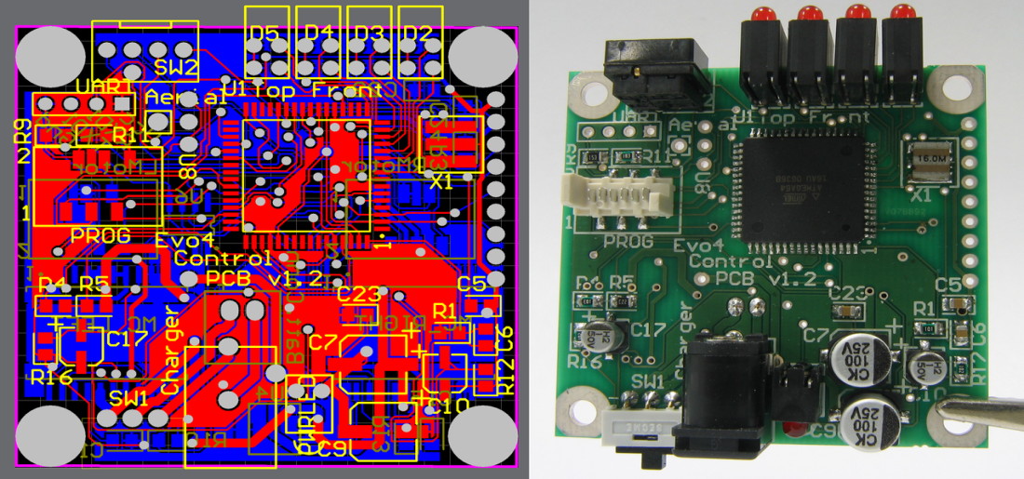
PRINTED CUIRCUIT BOARD
A printed circuit board (PCB) mechanically supports and electrically connects electronic components or electricalcomponents using conductive tracks, pads and other features etched from one or more sheet layers of copper laminated onto and/or between sheet layers of a non-conductive substrate. Components are generally soldered onto the PCB to both electrically connect and mechanically fasten them to it.
Printed circuit boards are used in all but the simplest electronic products. They are also used in some electrical products, such as passive switch boxes.
Alternatives to PCBs include wire wrap and point-to-point construction, both once popular but now rarely used. PCBs require additional design effort to lay out the circuit, but manufacturing and assembly can be automated. Specialized CAD software is available to do much of the work of layout. Mass-producing circuits with PCBs is cheaper and faster than with other wiring methods, as components are mounted and wired in one operation. Large numbers of PCBs can be fabricated at the same time, and the layout only has to be done once. PCBs can also be made manually in small quantities, with reduced benefits.
PCBs can be single-sided (one copper layer), double-sided (two copper layers on both sides of one substrate layer), or multi-layer (outer and inner layers of copper, alternating with layers of substrate). Multi-layer PCBs allow for much higher component density, because circuit traces on the inner layers would otherwise take up surface space between components. The rise in popularity of multilayer PCBs with more than two, and especially with more than four, copper planes was concurrent with the adoption of surface mount technology. However, multilayer PCBs make repair, analysis, and field modification of circuits much more difficult and usually impractical.
The world market for bare PCBs exceeded $60.2 billion in 2014.

